Slide 1

PPOC Summer Project
Inside an Election War Room
By team: Political Deceivers

Slide 2
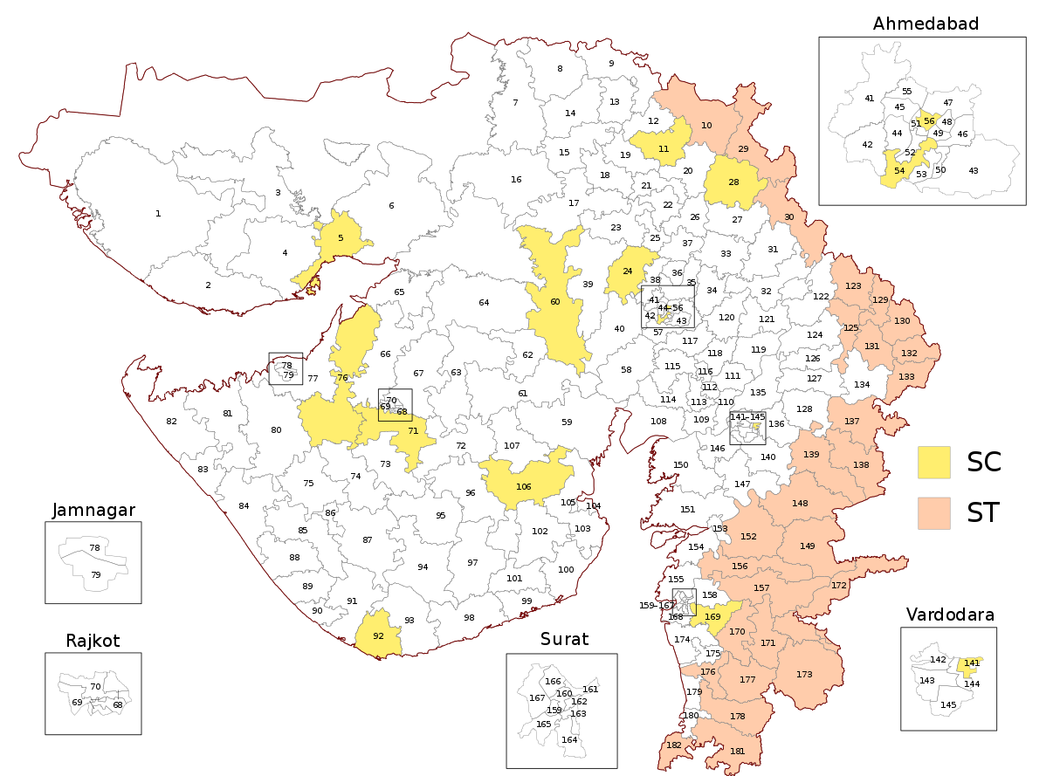
BACKGROUND
Gujarat legislative assembly elections are conducted on 182 seats for a usual term of 5 years. A majority mark of 92 seats is required to form a government. Out of 182 seats, 13 constituencies are reserved for scheduled castes and 27 constituencies are reserved for scheduled tribes.
Assembly Elections 2017:
Stats for AAP:-
AAP contested for 29 seats in 2017 Gujarat Legislative Assembly elections and received 0.1% vote share and won 0 seats with all its candidates losing their deposits.
Steps Taken:-
The party has dissolved its organizational structure in Gujarat to reorganize its structure in order to prepare for the elections. All the positions except the AAP state president post have been dissolved to replace it by a more powerful structure.

Slide 3
STRATEGY
The major task ahead of the party is to maximize its reach to booth level as the party needs to lay a strong foundation to counter BJP and Congress which collectively hold more than 95% share in seats and have in a way locked the entry of a new party in the state.
For this reason the party should reflect it as a better alternative through clear messaging and slogans in such a way that people readily connect to the party.
AAP, as it is restructuring itself in the state, should focus more on the established faces like recently joined Yuvraj Bhagirath Singh Vaghela, Lata Ben Bhatia, Himanshu Thakkar and Mahesh Savani.
The party should build a strong cadre base in the state by supporting local leaders rather than using National faces such as Arvind Kejriwal, Manish Sisodia regularly in campaigns.
The party’s leadership should try to keep the party together and strong by being a bit flexible on their decisions preventing malpractices like horse trading which could ruin all the hard work and efforts put together by the party.
From the previous trends it is clear that BJP has a strong base in the state and hence, the main focus should be to attract all the votes of all other parties under one umbrella of AAP, and then focussing on support base of BJP as the base of BJP is quite strong and it’s supporters are rigid of their party and are difficult to be converted.

Slide 4
MESSAGE
Party has to establish itself and majorly wants to reflect itself as an alternative party (which is clear from Arvind Kejriwal’s recent speech), the messaging of the party should be loud and clear.
The message that the party wants to deliver must be backed up by their work, for example the Delhi Model.
It is clear from the campaigning till now that the party is trying to make the public feel that BJP failed in what they promised, Congress is now incapable and they are requesting to give AAP a chance, which is quite similar to what they did in Punjab.
The above message is also reflected in the results of Gujarat Civic polls of October 2021.
The party may continue on the same lines, by using instances that have made life of people difficult in the BJP regime and show how they would make the public life easier and will be a better alternative.
People should be made aware of this message through all the present campaign methods and also possibly through ideas listed in creative campaign methods.

Slide 5
Target Voters:-
The party works on a line of not using a vote bank based on religion.
From the previous trends and strategy of the party it is clear that the target voters of the party are lower and middle class segments of urban areas.
Congress voters in rural as well as urban areas may see AAP as the alternative and may act as a major target.
Target Constituencies and Regions:-
Constituencies in Saurastra (part of gujarat containing kutch and bordering pak) where the tribal votebank is quite strong .
Constituencies in the Gandhinagar district (like Gandhinagar , mansa , kalol) where the popularity of the ruling party is not very strong , and these are currently ruled by the opposition
.
Urban Constituencies like Baroda and Ahemdabad.

Slide 6
Star Campaigners
Arvind Kejriwal:- He is the national convenor of the party and CM of Delhi. The party is usually identified by his face. His major role would be publicize his work done in Delhi and put forward the ambition that party has for the state of Gujarat.
Isudan Gadhvi:- He is Gujarat AAP’s face. He is an acclaimed journalist and a popular anchor of Gujarati media. he broke the news of Rs.150 crore scam of illegal trees cutting in Dang and Kaprada taluka of Gujarat. Following his report Gujarat government came into action, this incident helped Gadhvi rose to the fame. His main role will be to be the face of CM in gujarat and to publicise party’s work and form govt.
Sandeep Pathak - He is one of the closest confidantes of Kejriwal , kejriwal also told him to lead Gujarat . His role will be more on the backend part
Manish Sisodia
Raghav Chadha
Atishi Marlena
Sanjay Singh
Bhagwant Man

Slide 7
Issues to be raised!
Drug Trafficking:- Many cases of drug trafficking have been noticed by agencies in Gujarat. The Gujarat ports have been a common route for drug trafficking by drug mafias. Major case being seizure of drugs worth Rs. 15,000 crore from Mundra Port in Kutch.
Corruption:- Gujarat Anti-Corruption Bureau filed approx 173 cases in the year 2021. This issue can be represented best to be solved by the Delhi model where corruption was eradicated from its roots.
Water Crisis:- Central Ground Water Board indicated that the availability of water at 0 to 2 meters of ground level has reduced from 28% in 2019 to 23% in 2021, which even went to 18% in 2020.
Problems of industries:- Manufacturing industries are picking up momentum but face cost issues due to surge in demand of raw materials, power, logistics, shipping costs and labor shortage. For example, Morbi, a town in Gujarat which is Asia’s biggest ceramic manufacturing cluster, is facing a 15% shortage in labour.

Slide 8
Building a Cadre
Conduction of workshop:- Party should conduct workshops to motivate and guide elected corporators, office-bearers and party workers. Party candidates who lost their seat should explain their reason for losing to senior leaders and brainstorming sessions to be conducted to find real issues and their solutions.
Recruitment process:- The process of recruiting should be made more simpler and user friendly. There could be setting of booths in different constituencies where people are invited to register as volunteer.

Slide 9
Campaign Ideas
Door-to-door campaign:- Door-to-door campaigns are a traditional way of campaigning but are highly effective in connecting with people and branding of the party and candidates.
Cultural Programs: Garba nights will be organised where in policies of AAP would be publicised and the connection between the party and the people would be strengthened.
Deep Fakes: Technology like these would be used so that the AAP members can communicate in the local languages and create a larger impact on the public.
Open Town Hall, formal debates and discussions would be held at frequent intervals, media houses and opponent candidates would be called to showcase the propositions made
Gaining popularity through social media platforms with the help of IT cell.

Slide 10
Majority in Lok Sabha
Criterias:
The party should be recognized as a “National Party”
Minimum 55 Lok Sabha seats should be with the party

Slide 11
Strategy
Identifying states and constituencies having demographics similar to Delhi and Punjab so that the work done in these states can be related to the new policies that would be proposed.
Finding the target voters in those specific constituencies so that we can increase the vote bank and maximise the possibility of winning them.
Selecting suitable candidates who would be representing the constituencies and working with them to ensure that they are able to convey the parties message and motto to the general public easily.
Maximising the contact between the general public and the party members, and voicing the mistakes committed by the opposition party members.
Proposing ideas and policies as per the states/constituencies demands and linking them with the past work done by AAP in Delhi and Punjab.

Slide 12
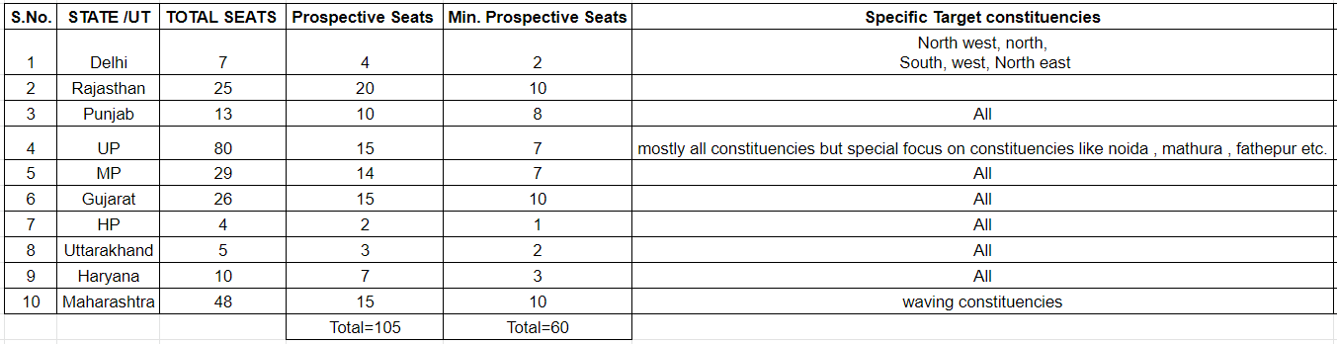
Target States/Constituencies

Slide 13
Resources
https://timesofindia.indiatimes.com/city/ahmedabad/acb-unearthed-disproportionate-assets-worth-rs-56-crore-in-gujarat-in-2021/articleshow/88671153.cms
https://en.wikipedia.org/wiki/2017_Gujarat_Legislative_Assembly_election
https://en.wikipedia.org/wiki/2012_Gujarat_Legislative_Assembly_election
https://indianexpress.com/article/political-pulse/battlelines-clear-gujarat-aap-congress-bjp-8009970/
https://www.newindianexpress.com/nation/2022/feb/14/gujarat-new-hub-for-drugtrafficking-states-coastline-preferred-route-of-smugglers-2419121.html#:~:text=Central%20and%20state%20agencies%20seized,daily%20seizure%20of%20169%20kg.
https://timesofindia.indiatimes.com/india/after-charging-up-cadre-pm-woos-gujarat-youth/articleshow/90176978.cms
https://indianexpress.com/article/political-pulse/battlelines-clear-gujarat-aap-congress-bjp-8009970/

Slide 14
Thank You!!
Team Members (Political Deceivers):-
Arnesh Dadich
Siddharth Garg
Anchit Gupta

